Slide 1
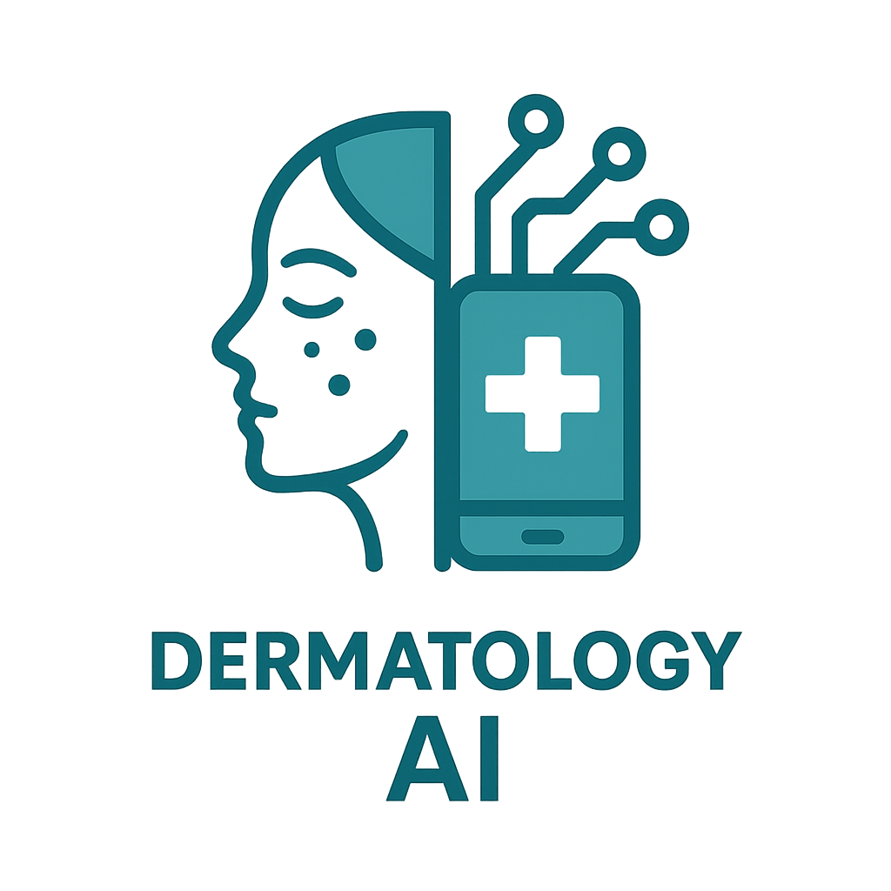
Skin Diseases Mobile App
1

Slide 2
Team Members
Name | Id
Youssef Abdelghfar Abdeltwab | 20210474
Amr Hesham Mohamed | 20210280
Yousef Ahmed Yousef | 20210461
Mahmoud Osama Shokry | 20210367
Omar Ashraf Helmy | 20210259
Supervised by
Dr: Mustafa Shiple
Dr: Wael Wahby
TA: Eman Salah
2

Slide 3

Abstract
Introduction
Contents
Similar Products
Methodology
Results
3

Slide 4
Abstract
4
Speaker: Omar

Slide 5
Abstract
Develop a mobile application with a dermatologist model for diagnosing skin diseases via visual examination of affected areas.
Users upload images, which then go through a preprocessing phase before proceeding to the clustering stage.
Clustering simplifies the model for embedding in an offline app.
After the first stage, it is fed into an AI model to perform image classification.
Importance lies in addressing the high prevalence of skin diseases affecting over 3 billion people globally. Treatment costs are staggering, with an estimated $53 billion spent annually on skin disease treatment in the US alone.
Early detection is crucial for improved survival rates. This highlights the app’s importance in enabling early diagnosis and potentially saving lives.
5
Speaker: Omar

Slide 6
Abstract
Application
Upload photo of Affected area
Upload photo of Affected area
Diagnosis of Skin Disease
Explain
6
Speaker: Omar

Slide 7
Introduction
7
Speaker: Omar

Slide 8
Introduction
What?
This project involves developing an initial model of a dermatologist for diagnosing diseases through visual examination of affected skin areas.
A mobile application enables patients to upload images, which are then preprocessed and analyzed by our classification model to diagnose the disease.
Results are promptly communicated to the patient including information about the condition’s nature, severity, and whether it is contagious.
Speaker: Omar
8

Slide 9
Introduction
Why?
Prevalence of Skin Diseases
Limited Access to Dermatological Services
Reducing Anxiety and Psychological Pressure
Early Detection and Intervention
Improving Awareness and Education
Providing Support and Guidance for Patients
9
Speaker: Omar

Slide 10
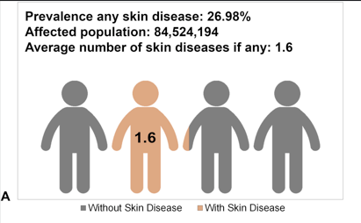
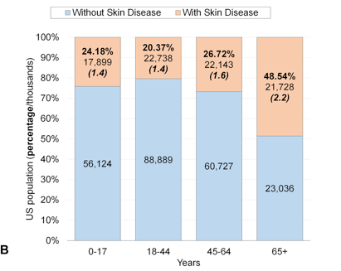
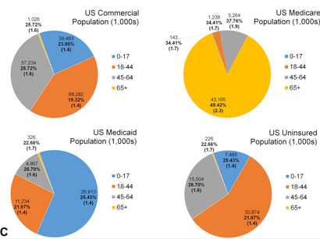
Introduction
Prevalence of Skin Diseases :
10
Speaker: Omar

Slide 11
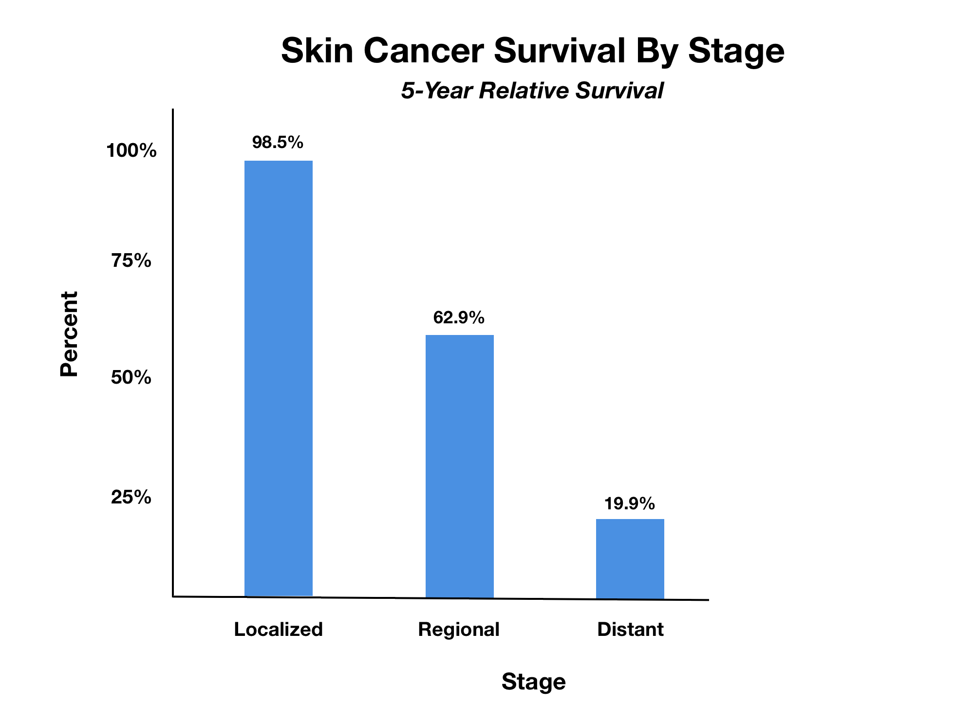
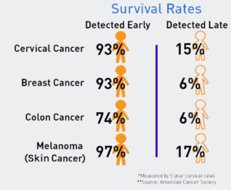
Introduction
Early Detection and Intervention
11
Speaker: Omar

Slide 12
Similar Products
12
Speaker: Youssef

Slide 13
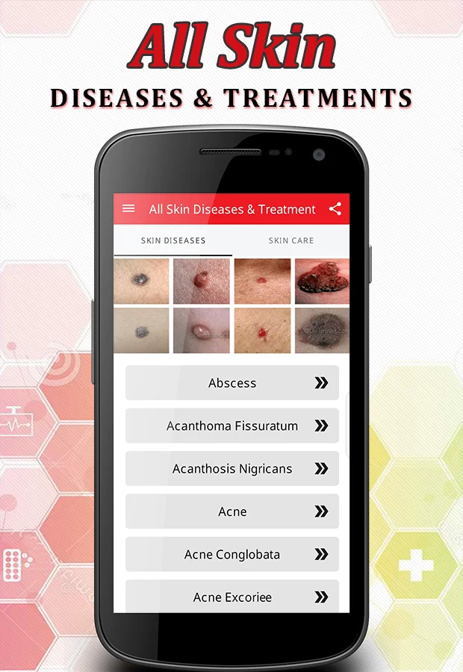
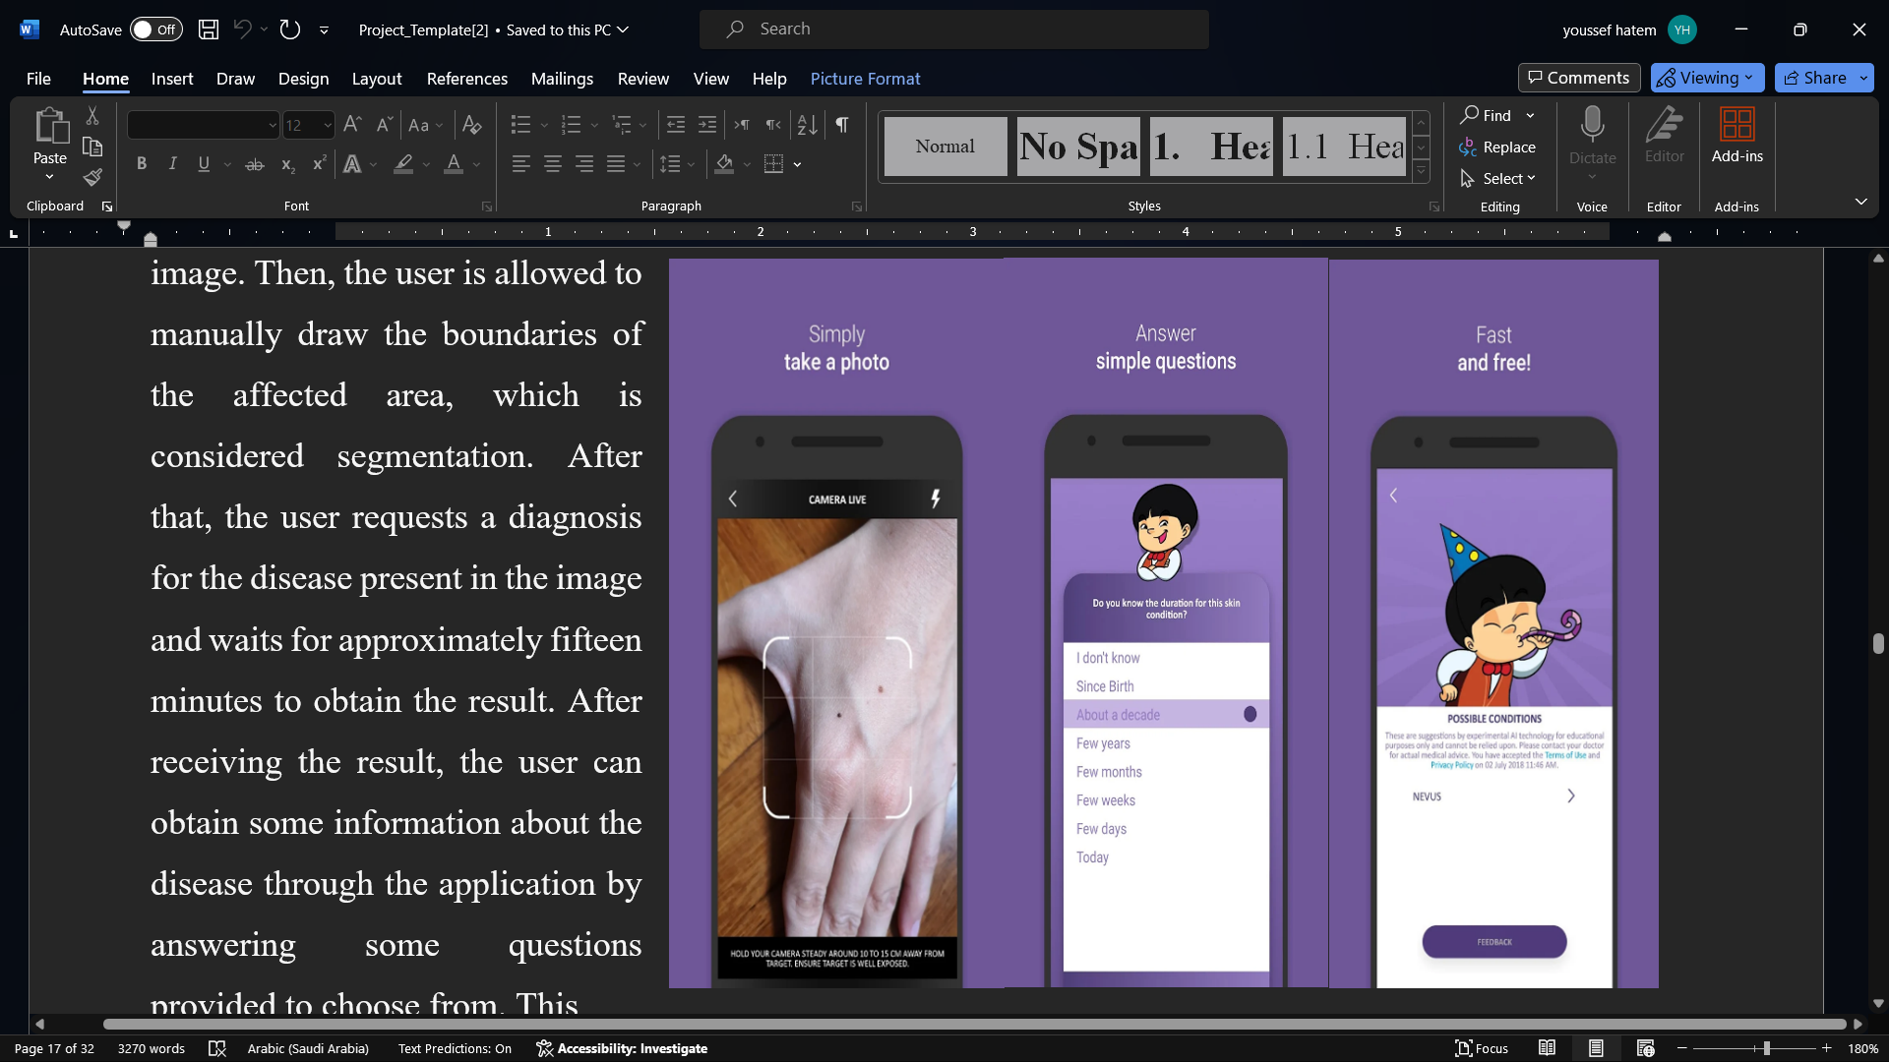
Similar Applications
All Skin Diseases
Medgic
13
Speaker: Youssef

Slide 14
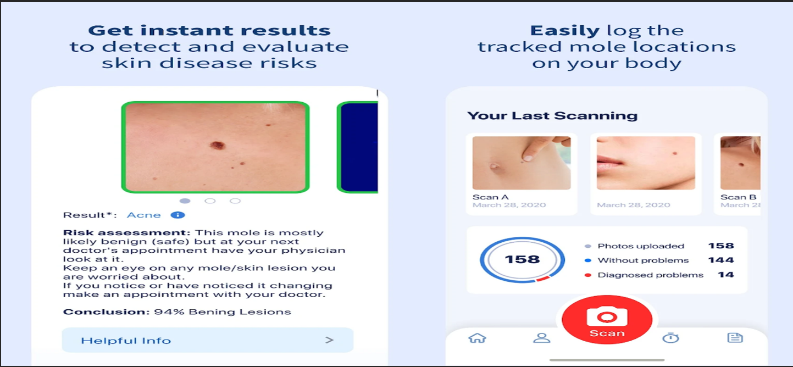
Similar Applications
Dermatologist
14
Speaker: Youssef

Slide 15
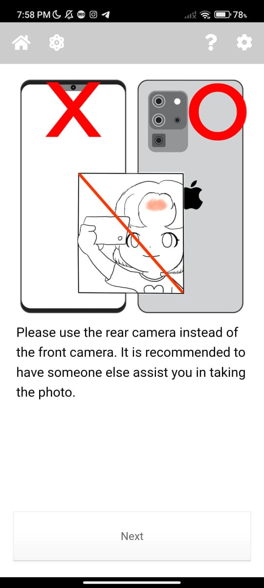
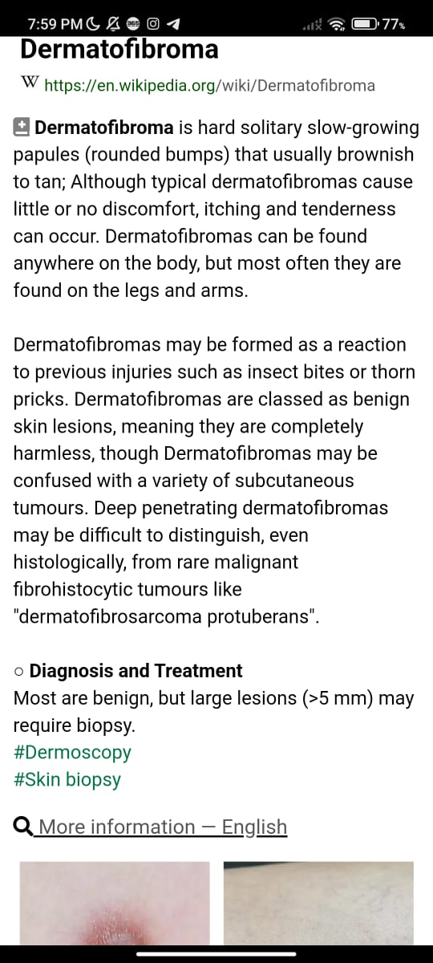
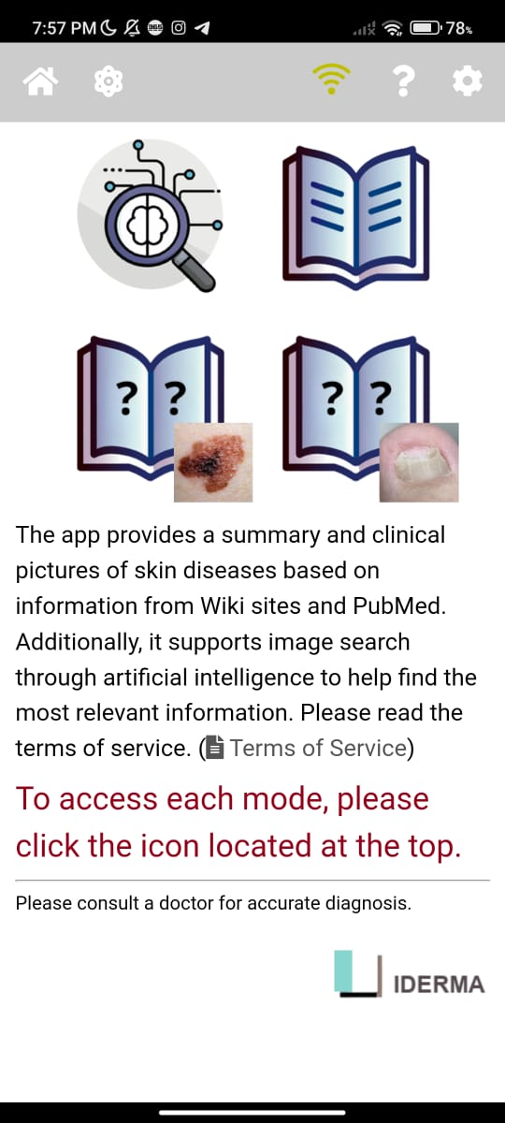
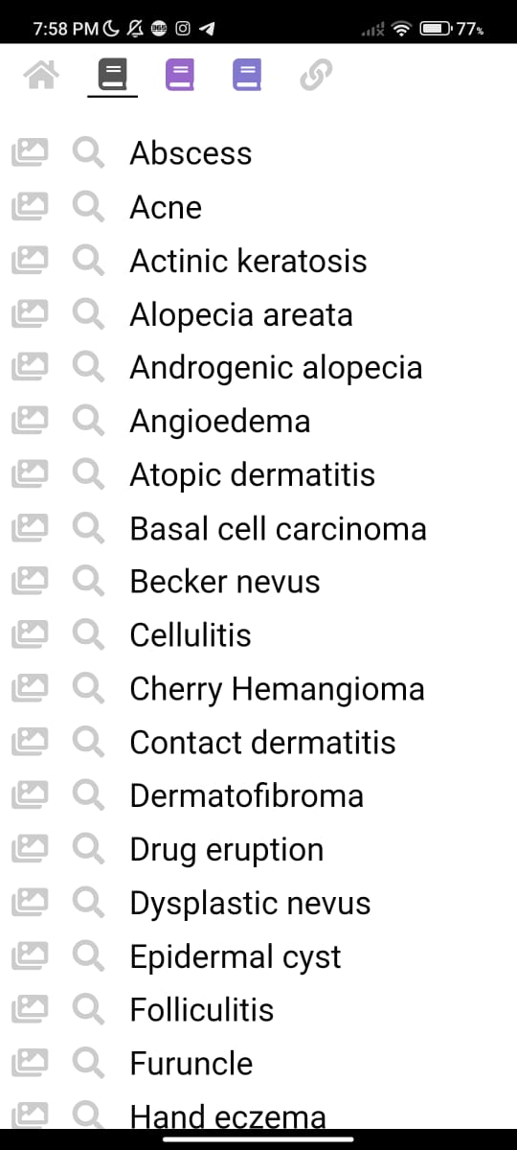
Similar Application
Model Dermatol- Skin Disease
Speaker: Youssef
15

Slide 16
Similar Papers
Papers | Accuracy | Number of Classes | Year | Reference
Paper by Snowber & Omker | 90% | 2 | 2024 | ResearchGate
Paper by Pratiwi | 97.2% | 7 | 2021 | ProQuest
Paper by Rehab | 99% | 2 | 2023 | IEEE
Paper by Huang | 95.8% | 2 | 2022 | IEEE
Paper by Dilip & Upendra & Mohanan | 97.53% | 4 | 2024 | Malque
Paper by Atyia & Syed & Habiba | 92% | 7 | 2025 | ResearchGate
Speaker: Youssef
16

Slide 17
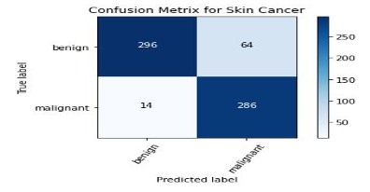
Similar Papers
Snowber & Omker Paper
CNNs
Speaker: Youssef
17

Slide 18
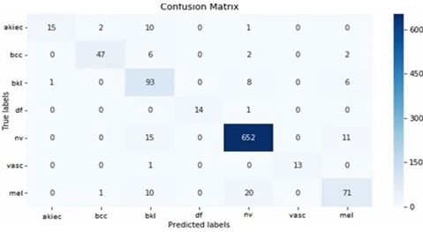
Similar Papers
Pratiwi Paper
Ensemble Model
Speaker: Youssef
18

Slide 19
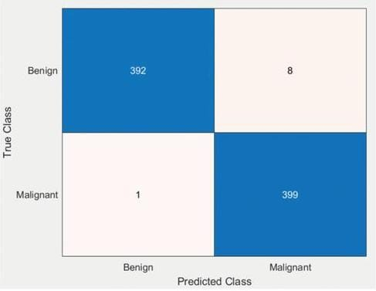
Similar Papers
Rehab Paper
KNN-PDNN
Speaker: Youssef
19

Slide 20
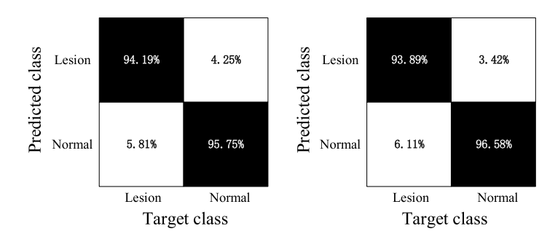
Similar Papers
Huang Paper
CNN
Speaker: Youssef
20

Slide 21
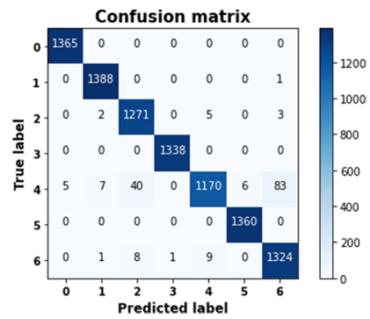
Similar Papers
Gunjan & Shashank & Gopal & Santosh Paper
Alex Net
Speaker: Youssef
21

Slide 22
Methodology
22
Speaker: Yousef

Slide 23
Methodology
Application
Upload All Images
Preprocessing Images
Image Classification
Explanation
Speaker: Yousef
23

Slide 24
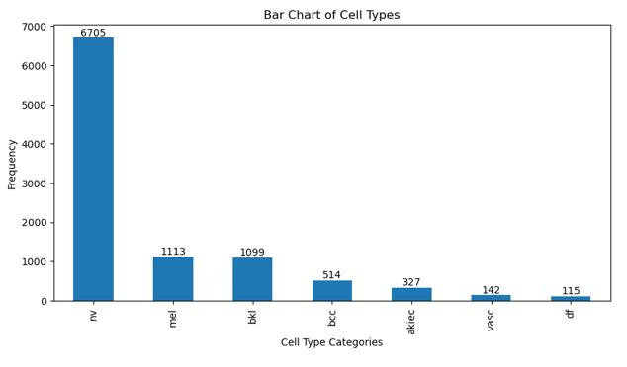
Work Done
HAM10000
Before Preprocessing
Unbalanced Data
Speaker: Yousef
24

Slide 25
Work Done
HAM10000
Solve Unbalance
Oversampling
Undersampling
Data Generator
SMOTE
Speaker: Yousef
25

Slide 26
Work Done
HAM10000
Image Data Generator
Why Use a Data Generator? The dataset is imbalanced and contains high-resolution images, so a data generator helps:
• Efficiently load and preprocess images in batches (memory-efficient)
• Augment the data (rotation, flipping, zooming, etc.)
• Increase variability
• Prevent overfitting
• Balance classes
Benefits Observed
• Reduced overfitting due to more diverse training samples.
• Improved model generalization.
• Easier to train on large datasets using batch-wise loading.
Speaker: Yousef
26

Slide 27
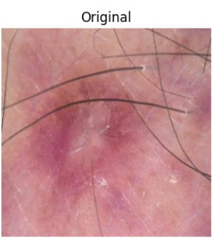
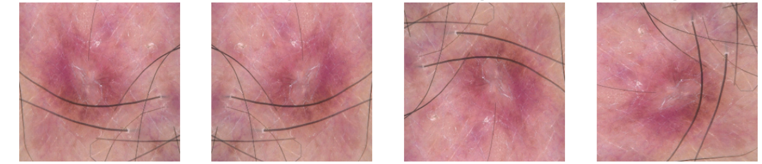
Work Done
HAM10000
Solve Unbalance
Data Generator
Rotating Flipping
Speaker: Yousef
27

Slide 28
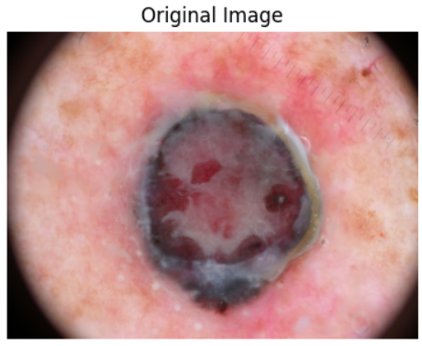
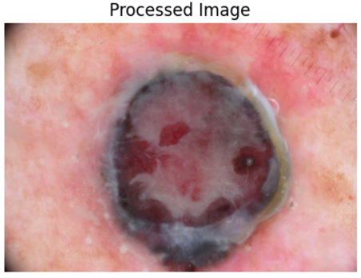
Work Done
Image Processing
Black Border
Speaker: Yousef
28

Slide 29
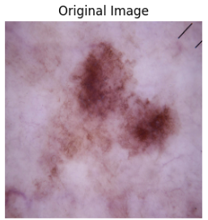
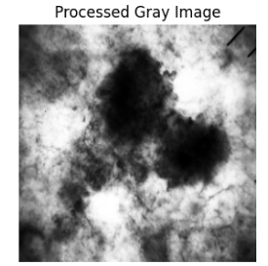
Work Done
Image Processing
Gray Scale
Speaker: Yousef
29

Slide 30
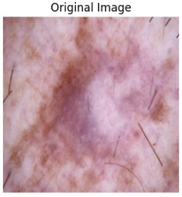
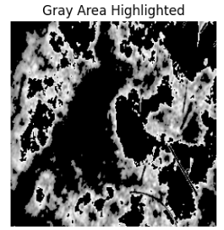
Work Done
Image Processing
Gray Area Highlighted
Speaker: Yousef
30

Slide 31
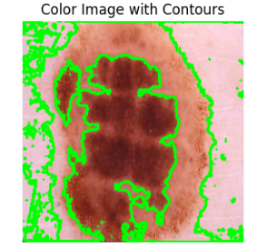
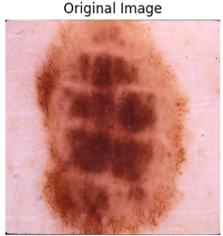
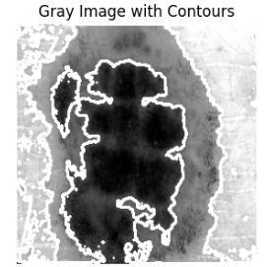
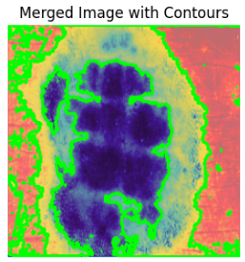
Work Done
Image Processing
Mask and Contour
Speaker: Yousef
31

Slide 32
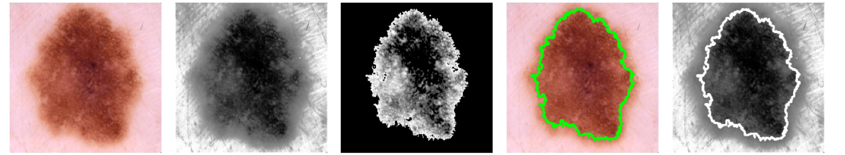
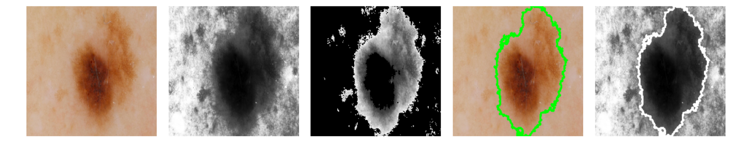
Work Done
Image Processing
Mask and Contour
Speaker: Yousef
32

Slide 33
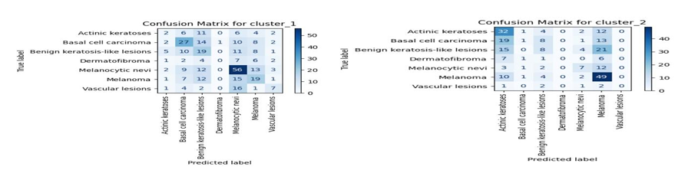
Attempts
Clustering
Image Processing
Extract Features
Clustering
Speaker: Yousef
33

Slide 34

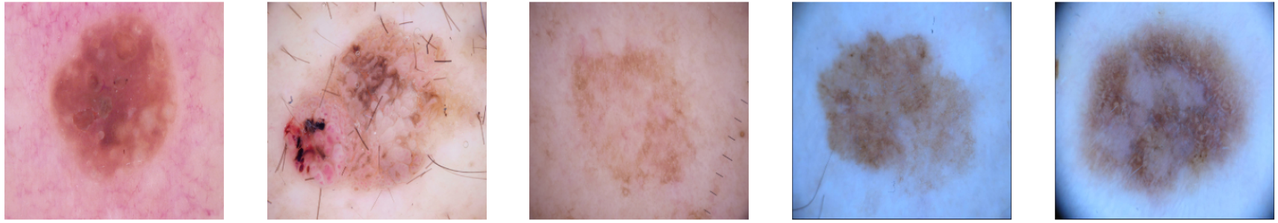

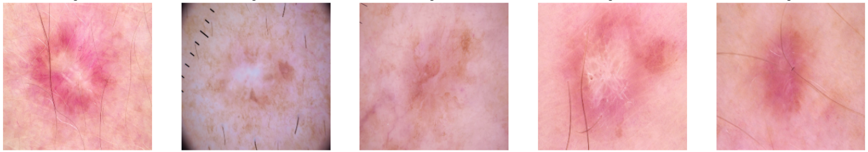
Attempts
Clustering
Speaker: Yousef
34

Slide 35
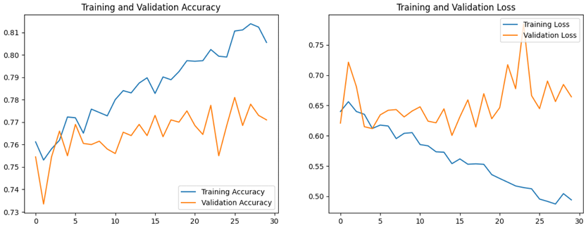
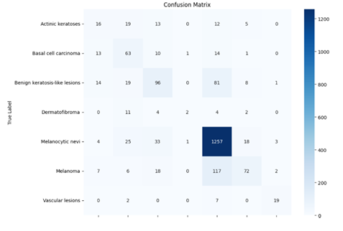
Attempts
CNN Model
Without Image Processing
Speaker: Youssef
35

Slide 36
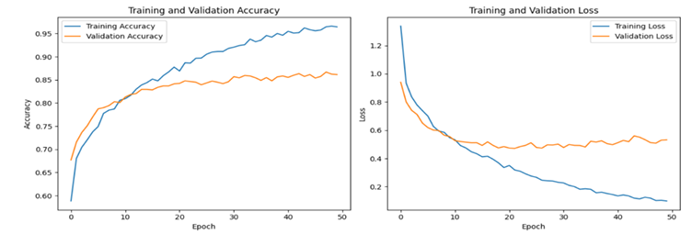
Attempts
Ensemble Model
Without Image Processing
InceptionV3, InceptionResNetV2, DenseNet201
Speaker: Youssef
36

Slide 37
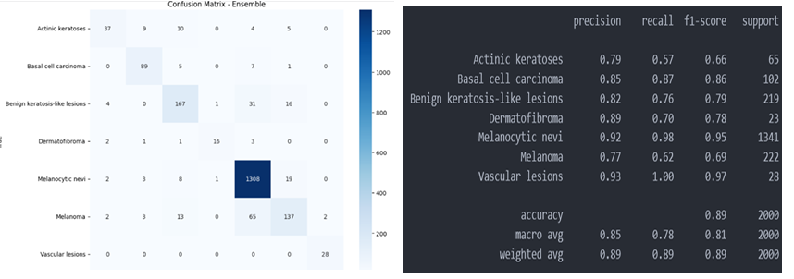
Attempts
Ensemble Model
Without Image Processing
InceptionV3, InceptionResNetV2, DenseNet201
Speaker: Youssef
37

Slide 38
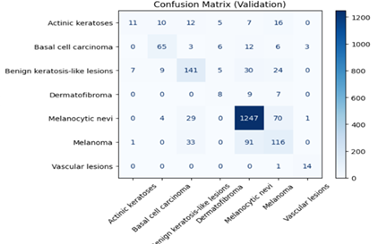
Attempts
Swin Transformer
Without Image Processing
Validation Accuracy: 79.98%
Speaker: Youssef
38

Slide 39
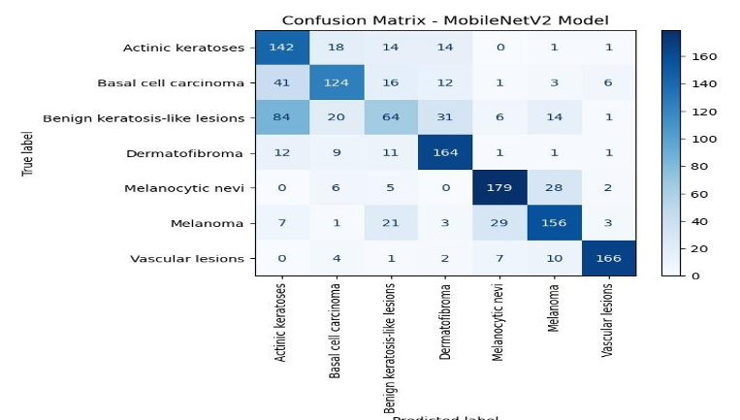
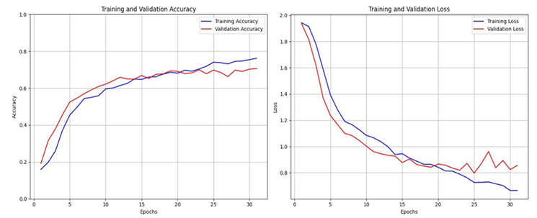
Attempts
MobileNet With 7 Classes
With Image Processing
Speaker: Amr
39

Slide 40
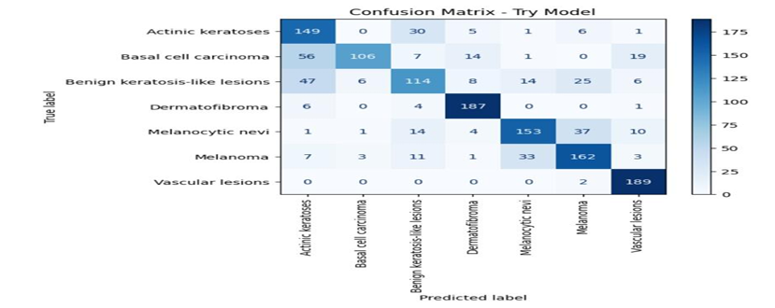
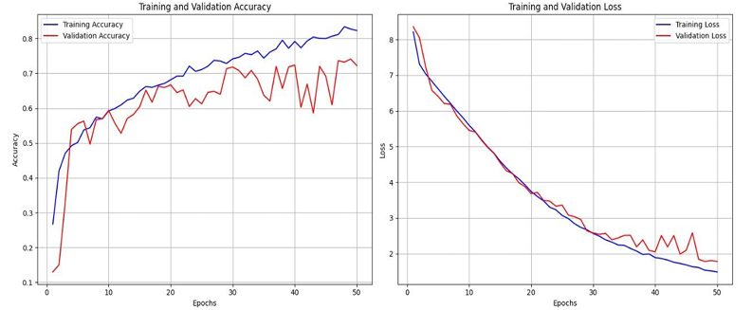
Attempts
CNN With 7 Classes
With Image Processing
Speaker: Amr
40

Slide 41
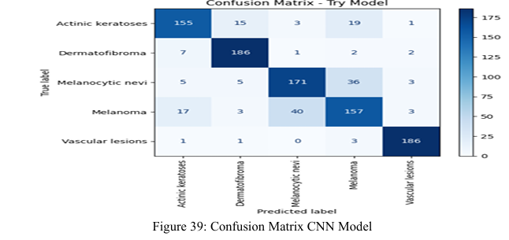
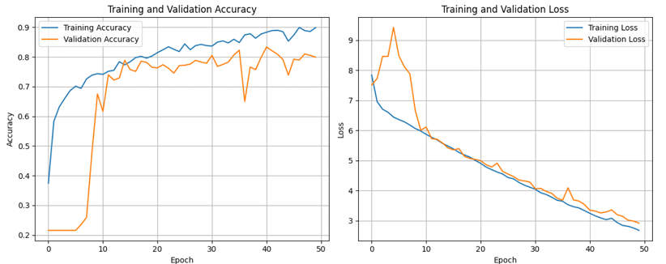
Attempts
CNN With 5 Classes
With Image Processing
Speaker: Amr
41

Slide 42
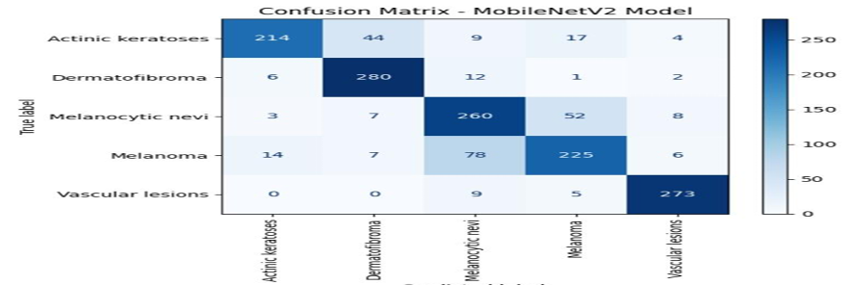
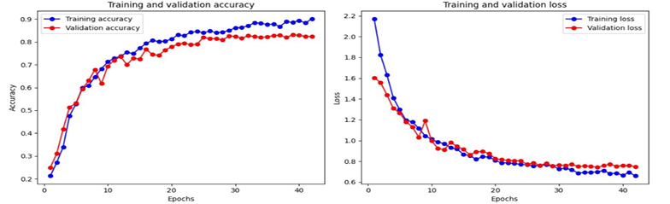
Attempts
MobileNet with 5 Classes
With Image Processing
Speaker: Amr
42

Slide 43
Work Done
Our Architecture
Model Summary
DenseNet201
Convolutional Layers
GlobalAveragePooling2D
Dropout
Speaker: Amr
43

Slide 44
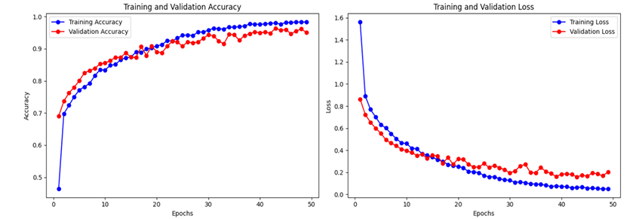
Work Done
DenseNet201
With Image Processing
Speaker: Amr
44

Slide 45

Work Done
DenseNet201
With Image Processing
Speaker: Amr
45

Slide 46

Work Done
DenseNet201
With Image Processing
Speaker: Amr
46

Slide 47

Application
Application Steps
Login if you have an Account
First Step
Speaker: Mahmoud
47

Slide 48

Application
Application Steps
Navigate to Home page
Second Step
Speaker: Mahmoud
48

Slide 49

Application
Application Steps
Pick Image From Gallery
Third Step
Speaker: Mahmoud
49

Slide 50

Application
Application Steps
Click ‘Upload Image’ to view the result
Fourth Step
Speaker: Mahmoud
50

Slide 51

Application
Application Steps
Navigate to the information page
Fifth Step
Speaker: Mahmoud
51

Slide 52

Application
Application Steps
Navigate to the information page
Sixth Step
Speaker: Mahmoud
52

Slide 53

Application
Application Demo
Speaker: Mahmoud
52

Slide 54
Results
53
Speaker: Mahmoud

Slide 55
Results
Architecture | Accuracy | Validation Acc | Test Acc
Our Architecture | 98% | 96.4% | 94.6%
Ensemble Without Processing | 96.7% | 88.5% | 89%
CNN Without Processing | 80.5% | 77% | 76%
CNN With 7 Classes | 83% | 73% | 72%
MobileNet With 7 Classes | 75% | 72% | 70%
MobileNet With 5 Classes | 90% | 82% | 80%
CNN With 5 Classes | 91% | 83% | 83.5%
Speaker: Mahmoud
54

Slide 56
Conclusion
CNNs for Skin Disease Classification
Utilized the Skin Cancer HAM10000 dataset with images of Seven skin diseases.
Faced initial challenges with Image Processing and Classification
Speaker: Mahmoud
55

Slide 57
Conclusion
Addressing Unbalanced Data
Employed techniques like data Augmentation by using Image Data Generator and SMOTE.
(Image Data Generator) proved most effective
Speaker: Mahmoud
56

Slide 58
Conclusion
Custom Architecture Development
Compared between classification with and without Image Processing
Achieved higher accuracy with image preprocessing techniques
Fine-tuned a Pretrained model (DenseNet201) tailored for skin disease classification.
Speaker: Mahmoud
57

Slide 59
Conclusion
Results and Analysis
Custom model and pre-trained models achieved high accuracy ( DenseNet201: 95%, Ensemble Learning: 89%).
DenseNet201 architecture handled the Seven classes effectively, showing superior performance.
Speaker: Mahmoud
58

Slide 60
Conclusion
Application Development Challenges
Developed a mobile application integrating TensorFlow and Flask.
Aimed to provide fast results and an easy-to-use app for scanning and diagnosing skin conditions.
Speaker: Mahmoud
59

Slide 61
Thanks

